Slide 1
Analysis of delays in MGNREGA by Data Mining Technique
Submitted by
V.Hyndavi-160116737066
N. Sai Nikhita-160116737076

Slide 2
Table of contents
Abstract
Project flow
Basics of Data mining
Weka
Outputs
Conclusion

Slide 3
Abstract
Internal studies conducted on MGNREGA resulted in delayed payment of wages. Our project gives the analysis of the payment of wages to the workers under this scheme
We strive to classify the states based upon the delay percentage , find out the reason for delay and rejection of delay compensation.

Slide 4
Project flow
Collect data set from officials
Upload the data set in Weka tool
Preprocess the data set
Apply J48 algorithm for classification
Analyze the output

Slide 5
What is data mining?
‘Knowledge mining from data’
To extract information from a data set and transform it into an understandable structure for further use.
Steps:
Data preprocessing
Data mining
Data analysis

Slide 6
Data preprocessing
Data cleaning: To fill in missing values manually, with global constant, with central tendency or ignoring the tuple
Data integration: For entity identification, redundancy, correlation analysis
Data reduction: To produce an efficient data set by compressing/reducing the unnecessary data
Data transformation: To transform data appropriate for mining

Slide 7
Data mining
Techniques
Classification: To construct a classification model and predict the class of every object
Clustering: To group similar data into same cluster
Regression: To identify relation between different attributes and predicting future value of object

Slide 8
What is Weka?
Weka is a collection of machine learning algorithms for data mining tasks.
The algorithms can either be applied directly to a dataset or called from your own Java code.
Weka contains tools for data pre-processing, classification, regression, clustering, association rules, and visualization.

Slide 9
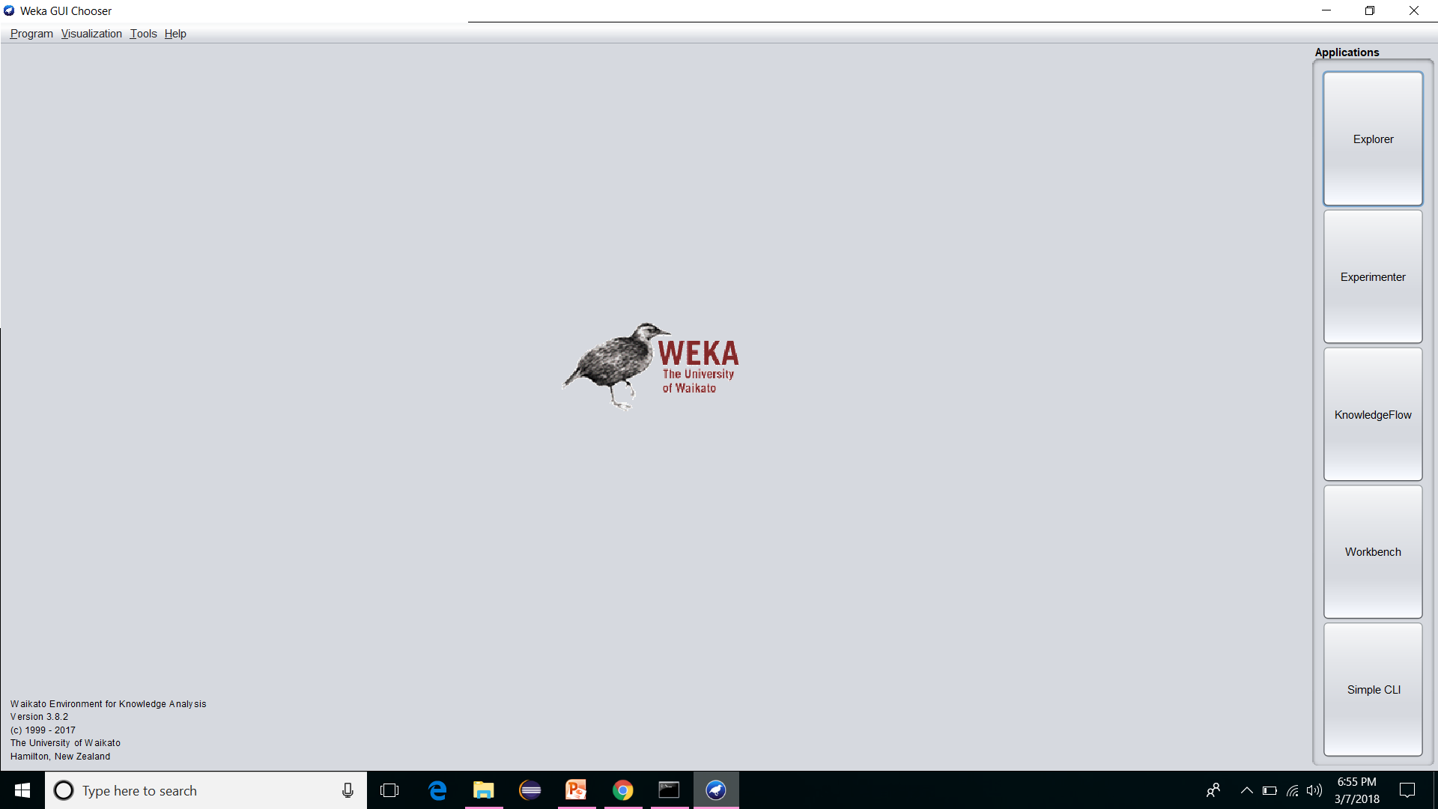
Weka Introduction Page

Slide 10
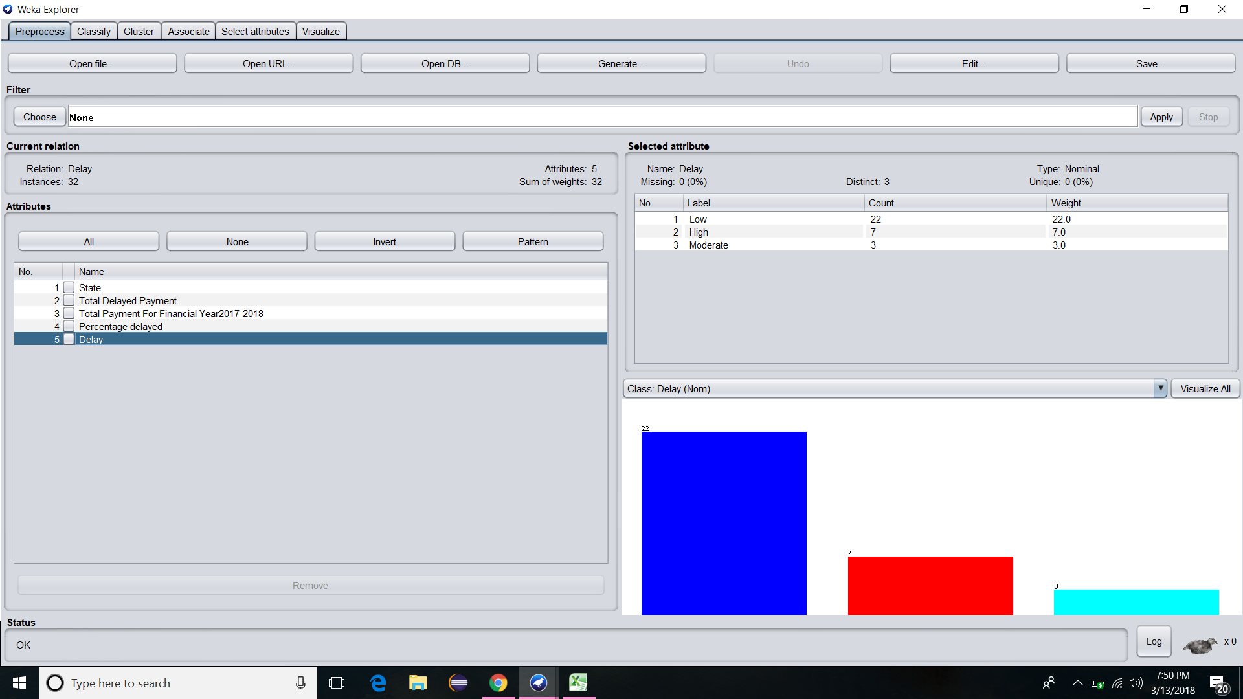
Preprocessing

Slide 11
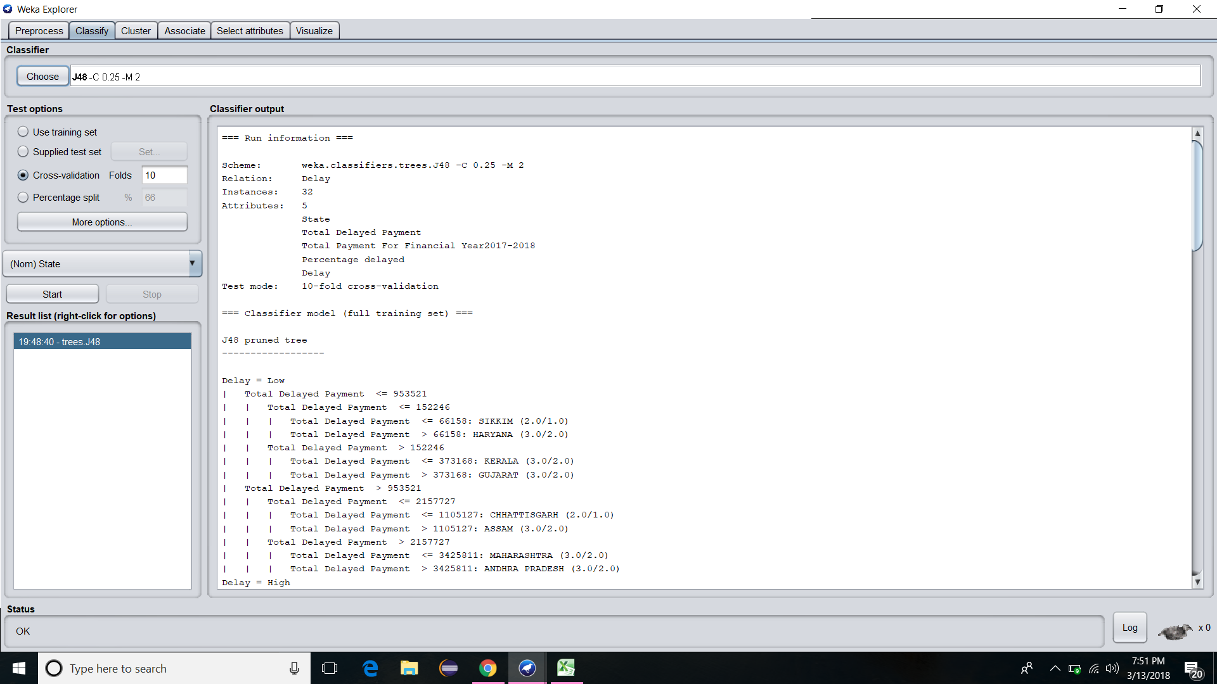
Classification

Slide 12
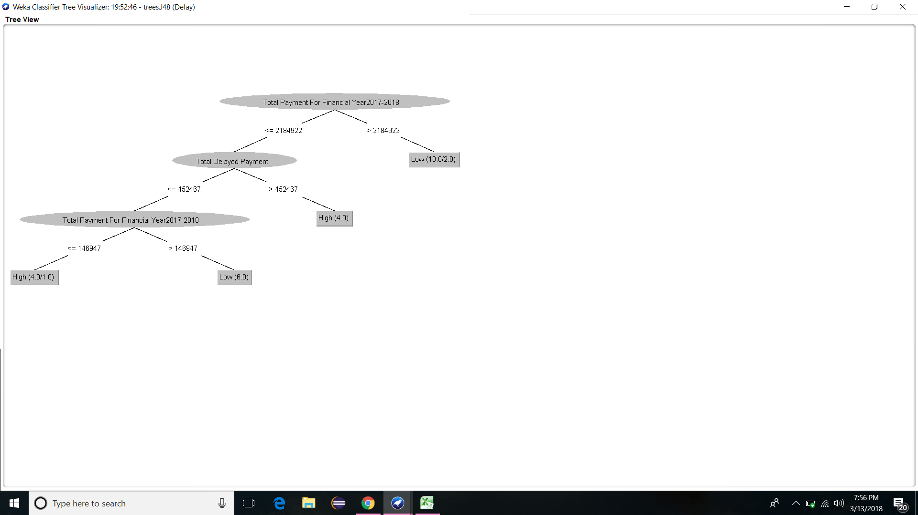
Outputs

Slide 13
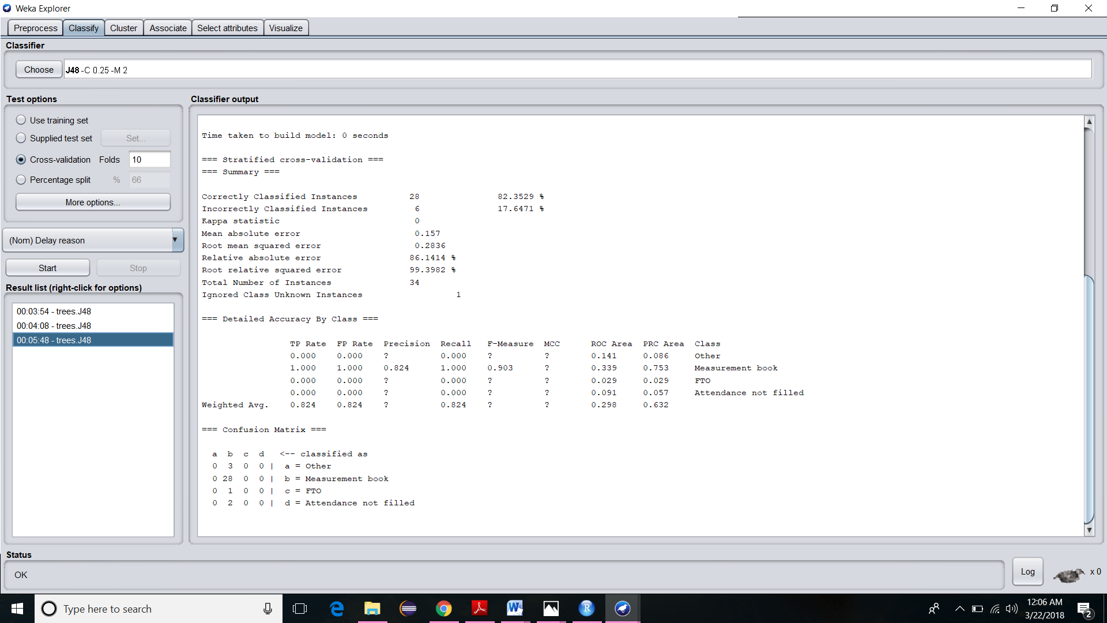
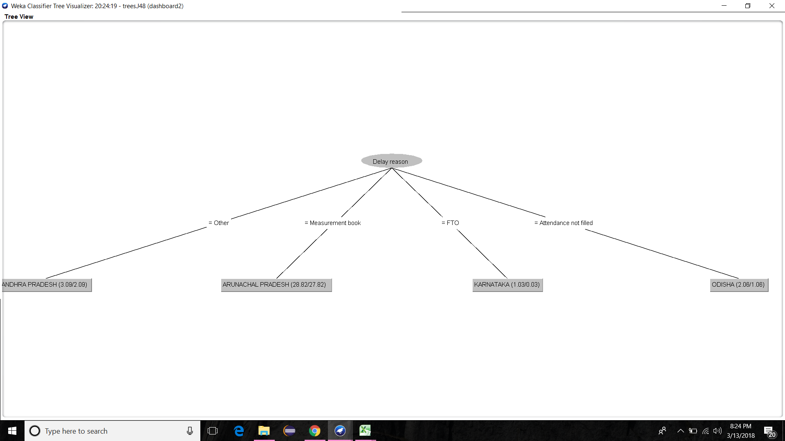

Slide 14
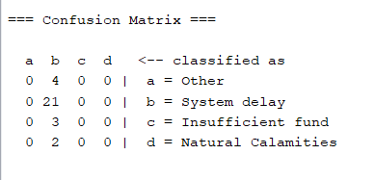
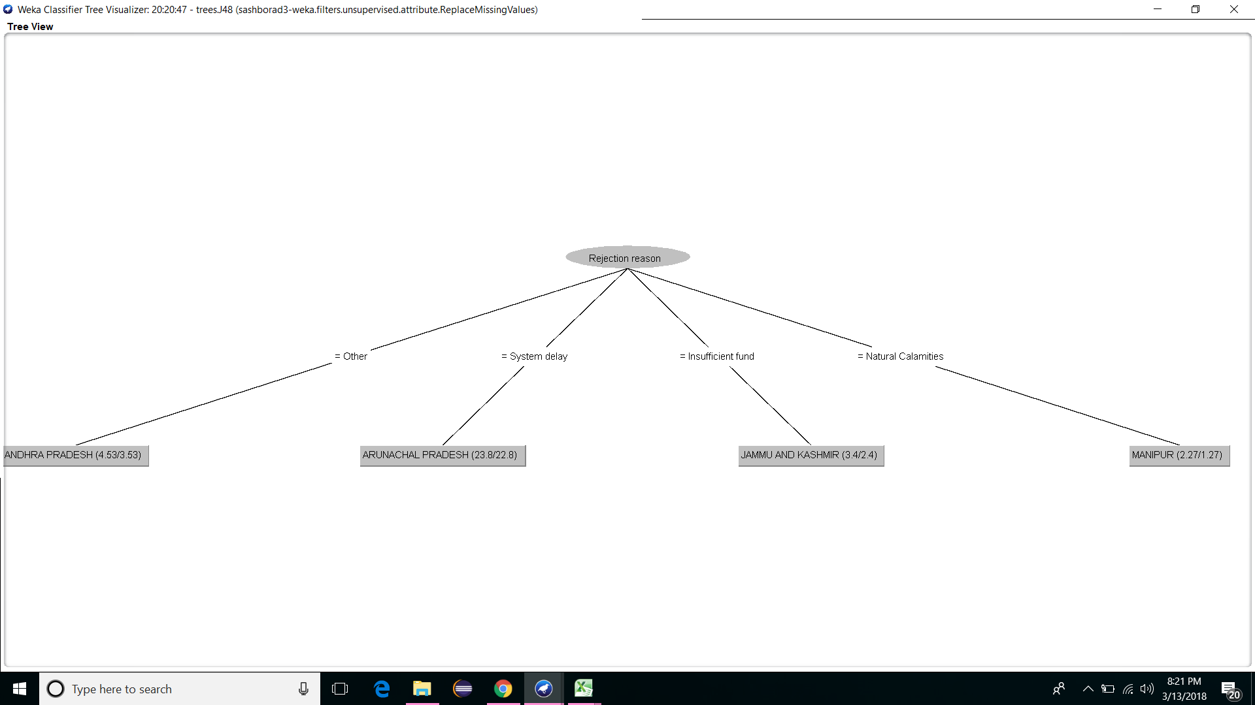

Slide 15
Conclusion
States have been classified based on delays.
The main reason of delay is found out to be measurement book.
The main reason for rejection of delay compensation is found out to be system delay.

Slide 16
Any queries?

